Slide 1


EcoIntelli: AI-Powered Sustainability Solutions
EcoIntelli harnesses the power of AI to revolutionize industrial sustainability. Our innovative approach combines efficiency analysis, strategic advising, and targeted outreach to drive eco-friendly business practices.
by Deeksha Math

Slide 2




Meet Our AI Team
Gemini: Efficiency Analyst
ChatGPT: Sustainability Advisor
Claude: Outreach Coordinator
Optimizes industrial processes using advanced machine learning techniques.
Ensures compliance and designs sustainable business models.
Focuses on marketing, PR, and industry engagement.

Slide 3

Gemini's Core Responsibilities
1
Industrial Process Optimization
Analyzes real-time data to detect inefficiencies and recommend improvements.
2
Predictive Maintenance
Uses machine learning to predict equipment failures and reduce downtime.
3
Energy Consumption Reduction
Tracks energy usage and suggests efficient alternatives.
4
Resource Allocation & Waste Reduction
Optimizes raw material use and implements predictive demand forecasting.

Slide 4




Sustainable Supply Chain Management
Optimize Logistics
Reduce fuel consumption and emissions in transportation.
Eco-Friendly Suppliers
Assist in selecting sustainable raw materials and partners.
Risk Analysis
Automate supply chain risk assessment using AI models.

Slide 5
Compliance & Decision Support
Regulatory Reporting
Executive Decision Support
Gemini ensures AI solutions align with environmental regulations. It generates automated sustainability reports for stakeholders.
Provides data-backed recommendations for new business strategies. Assists in scenario planning to predict AI intervention impacts.

Slide 6



AI Collaboration Workflow
ChatGPT
2
Validates data against regulations and generates reports.
Gemini
1
Sends efficiency and sustainability insights.
Claude
3
Creates engaging content and manages client communication.

Slide 7
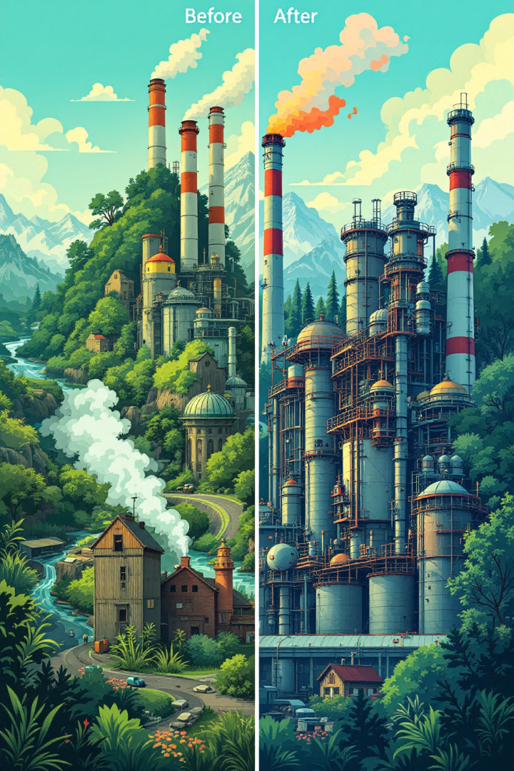
EcoIntelli's Impact
Optimized Efficiency
Streamlined industrial processes reduce waste and improve productivity.
Reduced Environmental Impact
Lower carbon footprint and improved resource management.
Cost Savings
Process automation and predictive maintenance cut operational costs.
Regulatory Compliance
Ensure adherence to sustainability regulations and standards.

Slide 8

Join the Sustainable Revolution
EcoIntelli's AI-powered solutions pave the way for a sustainable industrial future. Partner with us to optimize your operations, reduce environmental impact, and drive innovation in your industry.

